Slide 1

Data Mining in Action
Intro into DL

Slide 2
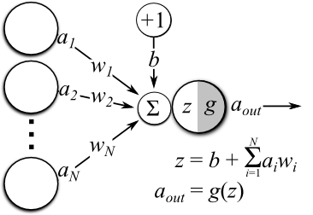
Linear model

Slide 3

Dense neural network
http://cs231n.github.io/neural-networks-1

Slide 4
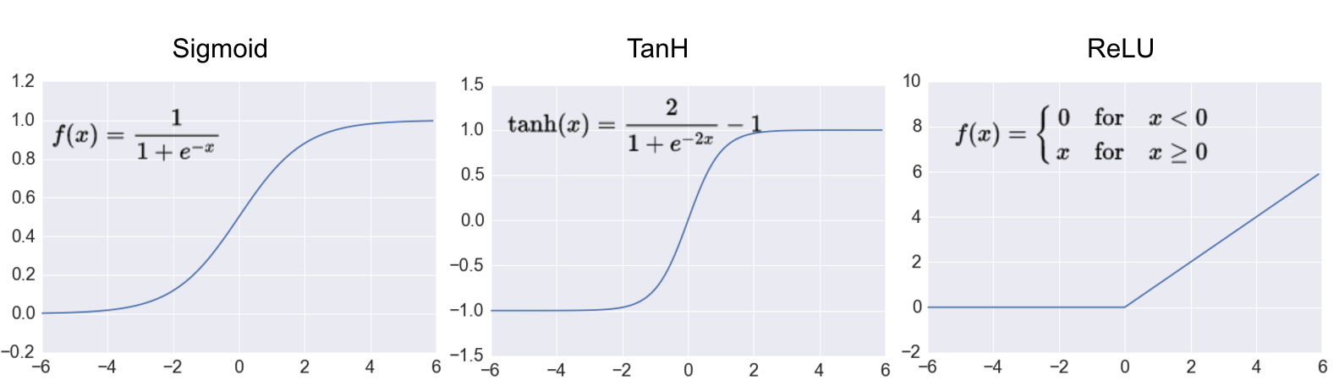
Activation functions
More: LeakyReLU, elu, softplus, selu …
https://keras.io/activations/

Slide 5
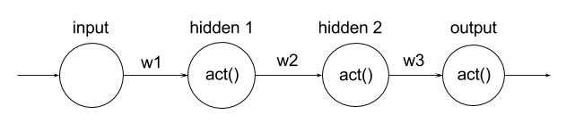
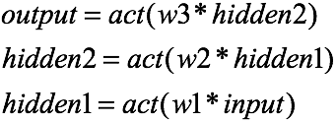
BackPropagation
https://ayearofai.com/rohan-lenny-1-neural-networks-the-backpropagation-algorithm-explained-abf4609d4f9d

Slide 6
BackPropagation
https://ayearofai.com/rohan-lenny-1-neural-networks-the-backpropagation-algorithm-explained-abf4609d4f9d

Slide 7
BackPropagation
https://ayearofai.com/rohan-lenny-1-neural-networks-the-backpropagation-algorithm-explained-abf4609d4f9d

Slide 8
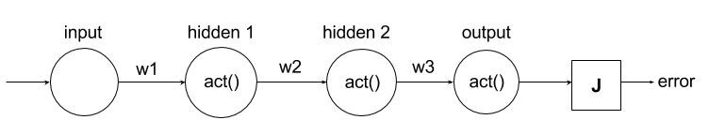
BackPropagation
https://ayearofai.com/rohan-lenny-1-neural-networks-the-backpropagation-algorithm-explained-abf4609d4f9d

Slide 9
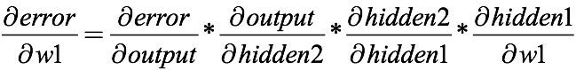
BackPropagation
https://ayearofai.com/rohan-lenny-1-neural-networks-the-backpropagation-algorithm-explained-abf4609d4f9d

Slide 10
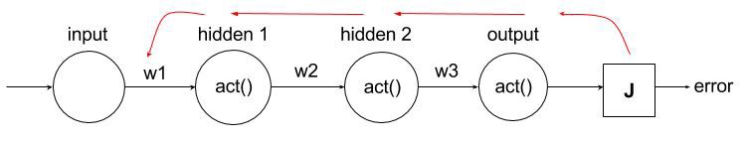
BackPropagation
Forward pass
Backward pass
https://ayearofai.com/rohan-lenny-1-neural-networks-the-backpropagation-algorithm-explained-abf4609d4f9d

Slide 11
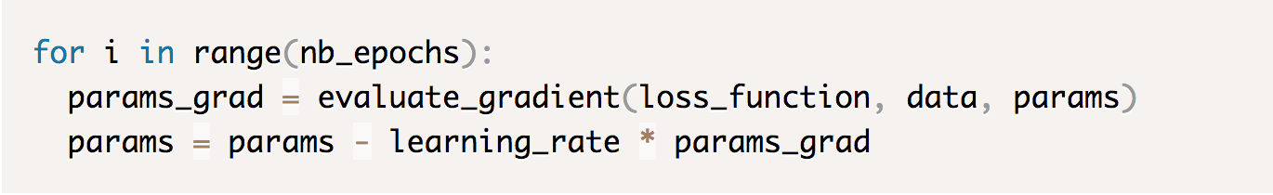
Optimization methods
Gradient descent
http://ruder.io/optimizing-gradient-descent/

Slide 12
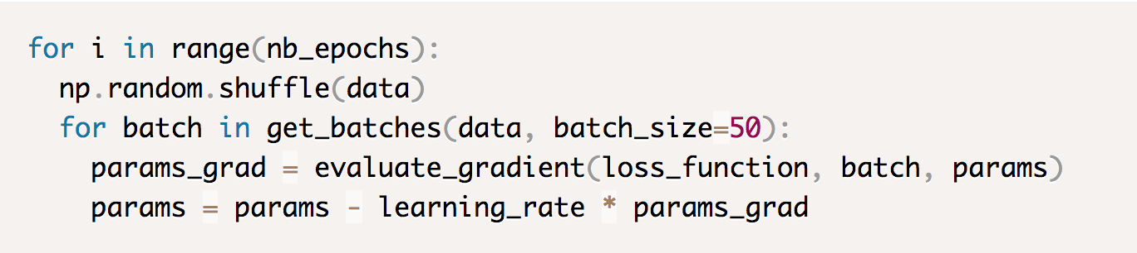
Optimization methods
Gradient descent
Mini-batch gradient descent
http://ruder.io/optimizing-gradient-descent/

Slide 13
Optimization methods
Gradient descent
Mini-batch gradient descent
http://ruder.io/optimizing-gradient-descent/

Slide 14
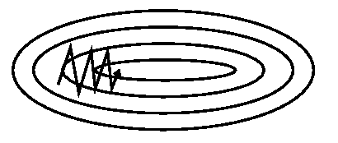
Optimization methods
Mini-batch gradient descent
http://ruder.io/optimizing-gradient-descent/

Slide 15
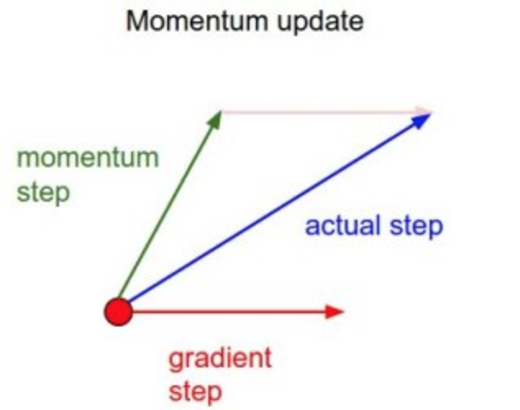
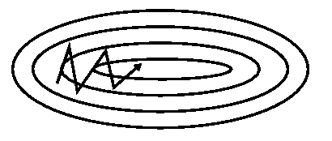
Optimization methods
With momentum
Without momentum
http://ruder.io/optimizing-gradient-descent/

Slide 16


http://ruder.io/optimizing-gradient-descent/

Slide 17
Regularization
Dropout: A Simple Way to Prevent Neural Networks from Overfitting

Slide 18
Images

Slide 19




Convolutions
No padding, no strides
No padding, strides
Half padding, no strides
Full padding, no strides
https://github.com/vdumoulin/conv_arithmetic

Slide 20
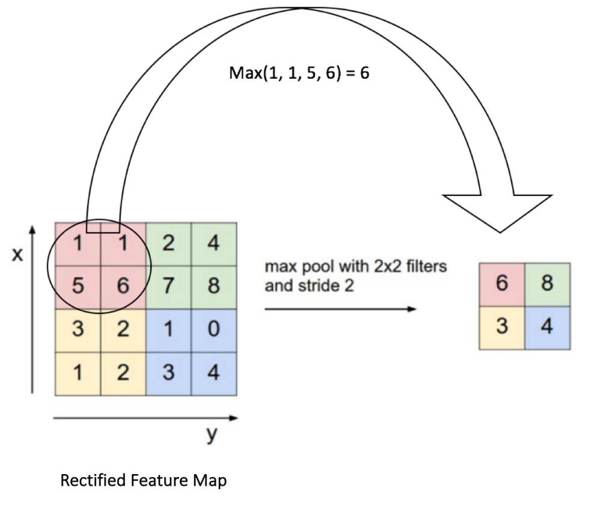
Pooling
https://ujjwalkarn.me/2016/08/11/intuitive-explanation-convnets/

Slide 21
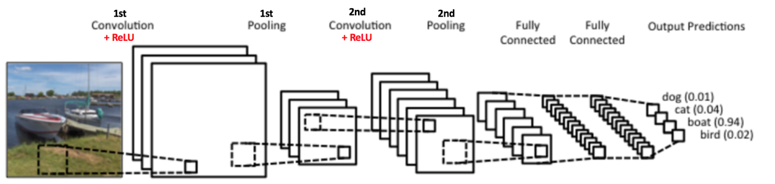
CNN

Slide 22
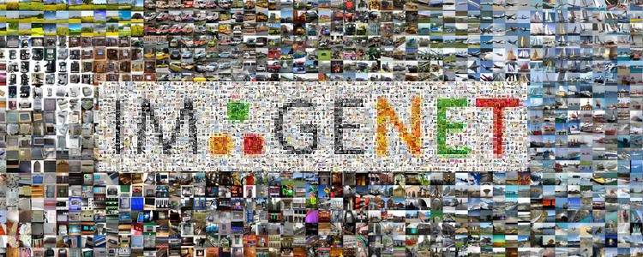
1000 classes, 1.2 millions train, 100k test

Slide 23
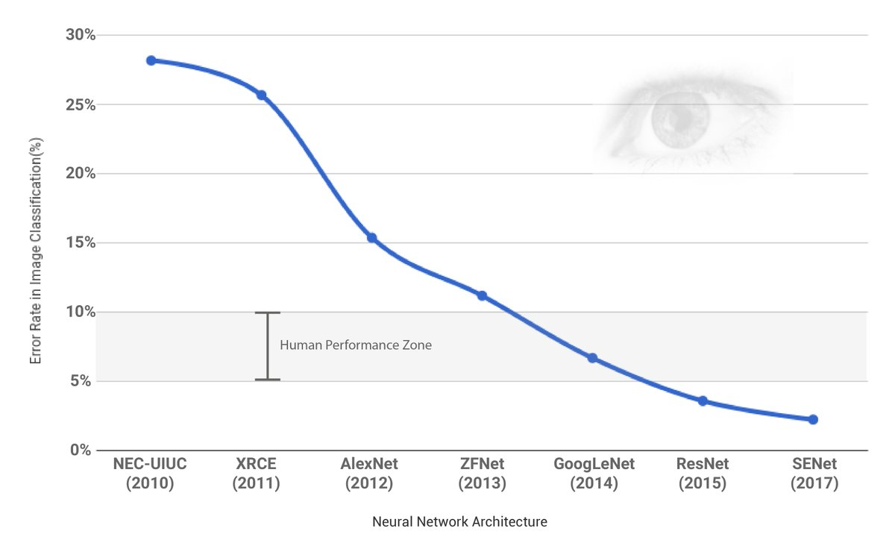

Slide 24
AlexNet
ImageNet Classification with Deep Convolutional Neural Networks

Slide 25

VGG16

Slide 26
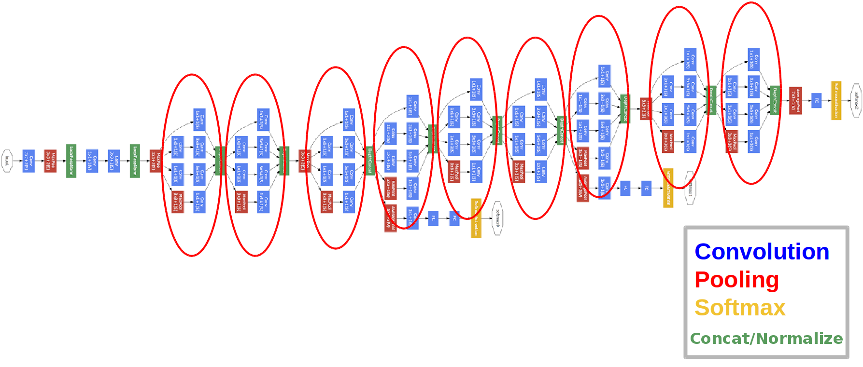
GoogleNet (22 layers)

Slide 27
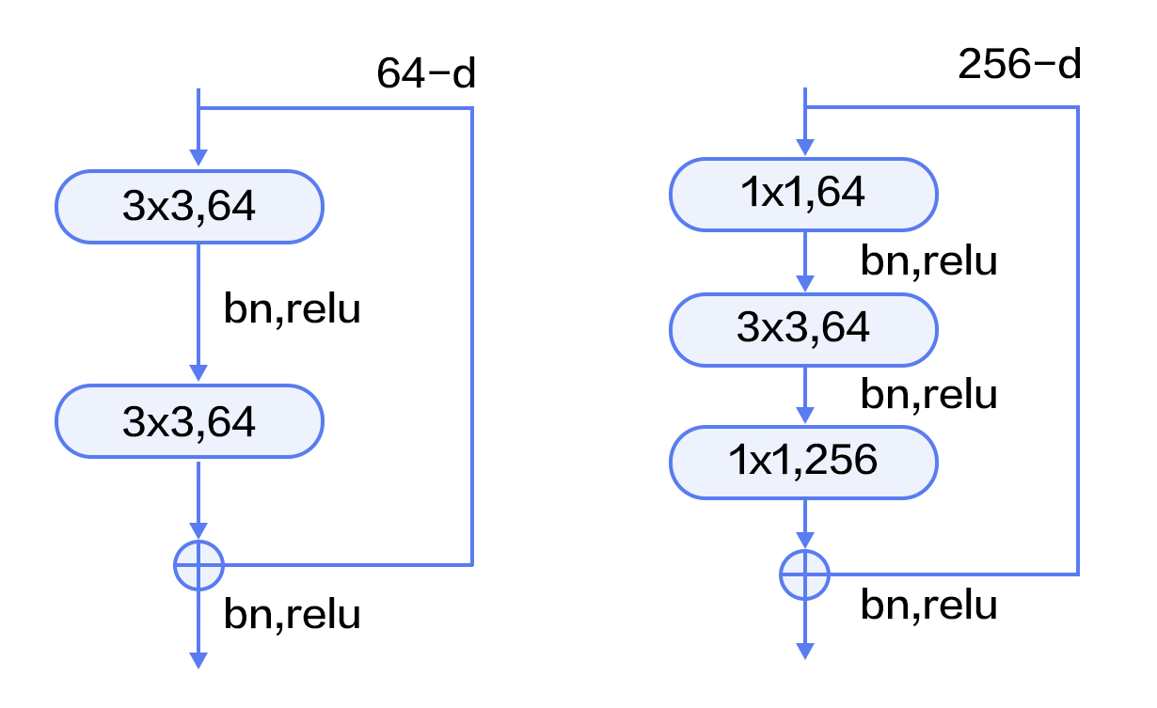
ResNet
http://book.paddlepaddle.org/03.image_classification/

Slide 28
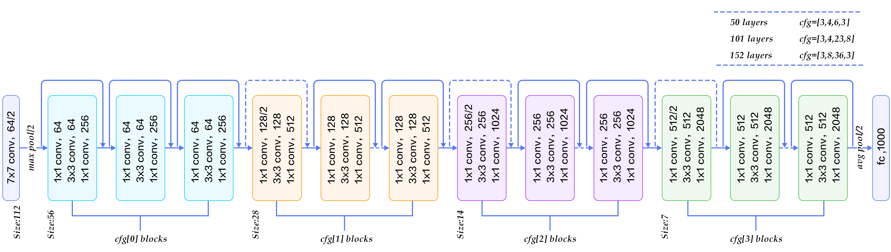
ResNet
http://book.paddlepaddle.org/03.image_classification/

Slide 29
SeNet
Squeeze-and-Excitation Networks

Slide 30
Texts

Slide 31
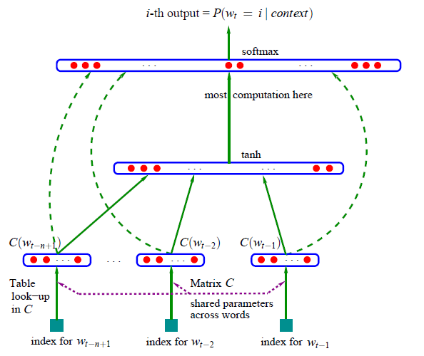
Embeddings

Slide 32
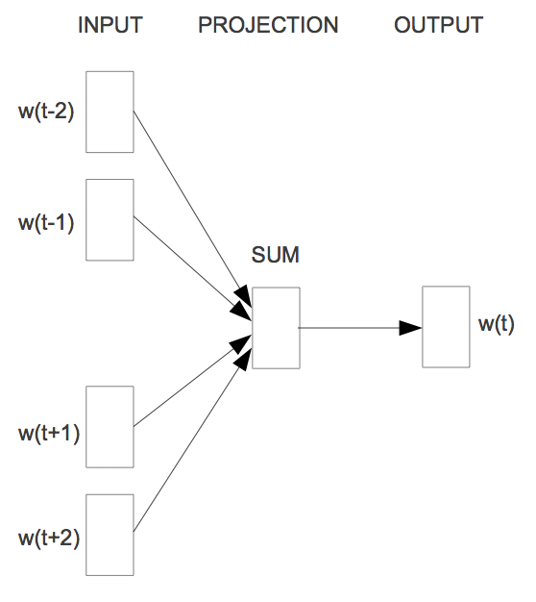
CBOW Word2Vec

Slide 33
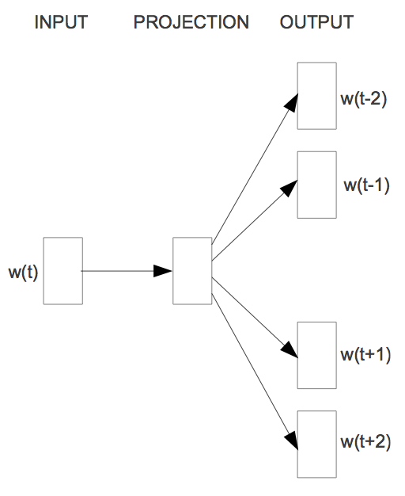
Skip-gram Word2Vec

Slide 34


Slide 35
Convolutional text classification
Character-level Convolutional Networks for Text Classification

Slide 36
Sequences

Slide 37

Problems
http://karpathy.github.io/2015/05/21/rnn-effectiveness/

Slide 38
Problems
vanilla
Image captioning
Sentiment analysis
Machine translation
Video classification
http://karpathy.github.io/2015/05/21/rnn-effectiveness/

Slide 39
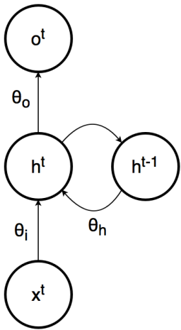
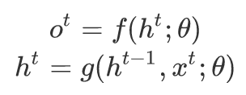
Recurrent neural network
https://brilliant.org/wiki/recurrent-neural-network/

Slide 40
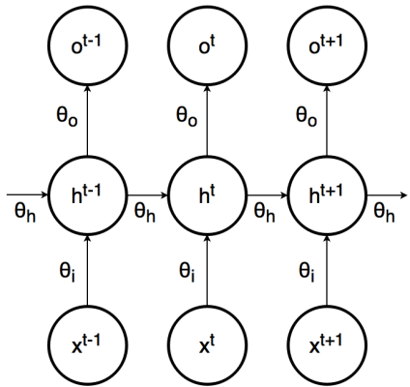
Recurrent neural network
https://brilliant.org/wiki/recurrent-neural-network/

Slide 41
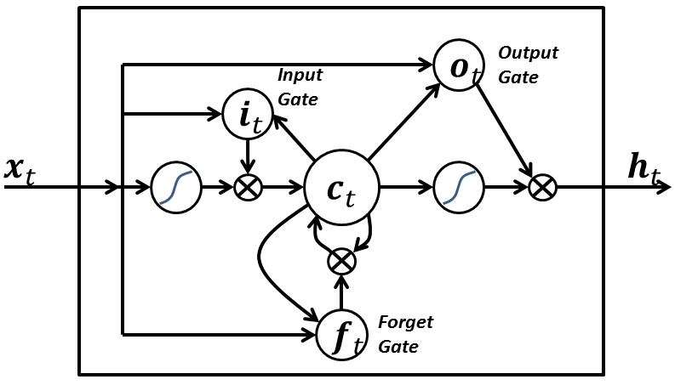
Recurrent neural network
https://brilliant.org/wiki/recurrent-neural-network/

Slide 42
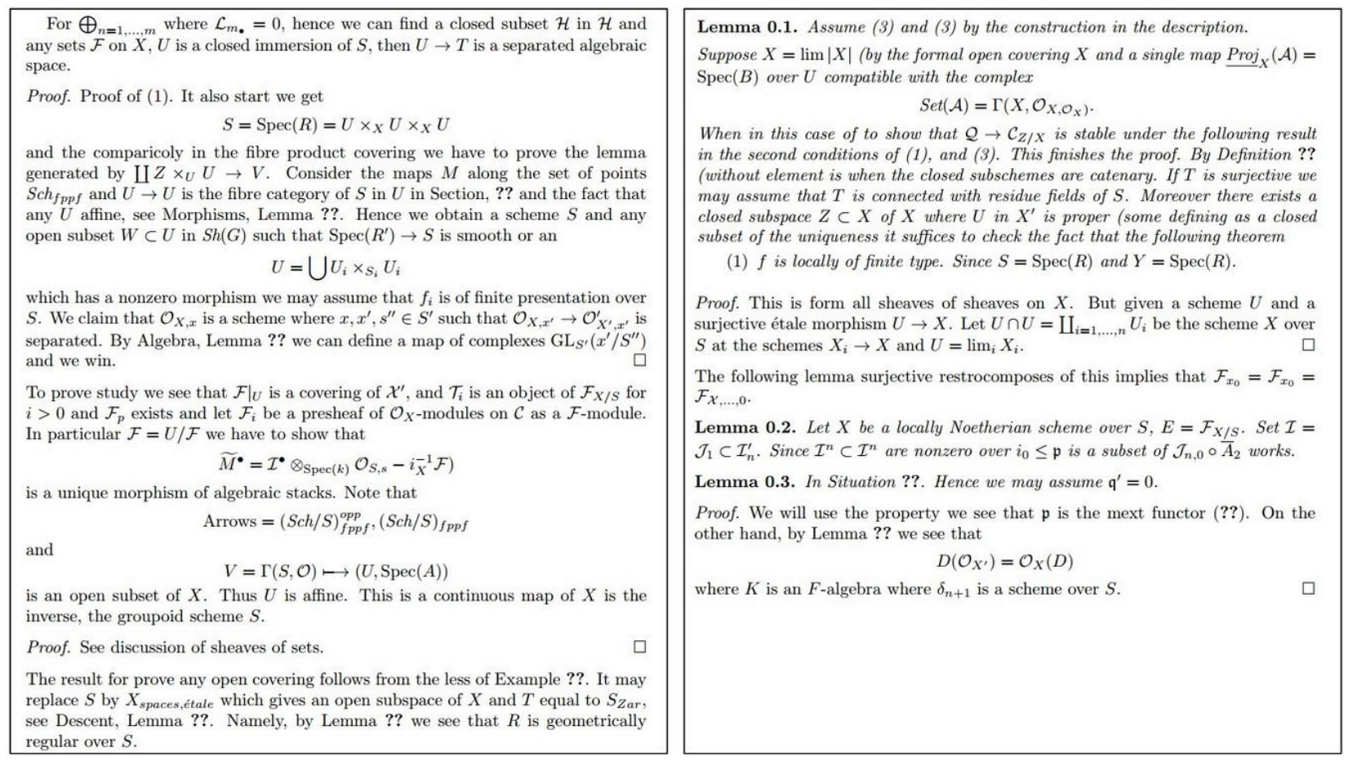

Slide 43
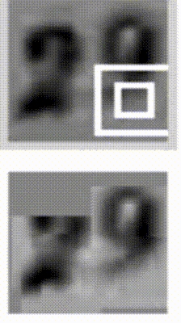
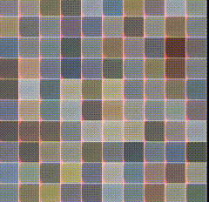
https://arxiv.org/abs/1412.7755
https://arxiv.org/abs/1502.04623

Slide 44
Questions?

